Slide 1




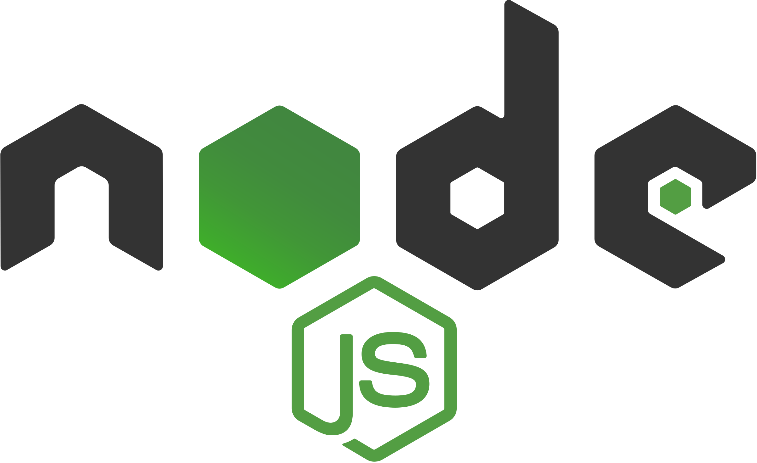

Online Board Game
Dawid Gorski – Michael Fairbank
Sign Up
Pick a Room
Play!
Overview
This online monopoly game allows you to play with up to 4 friends from anywhere in the world. The game board is drawn using HTML and CSS. Nodejs was used to make this into a scalable application, so that multiple games can be played at the same time. Socketio is used to transfer data between the client and the server, so for example when a user sends a message or when a player rolls the dice.
Most of the game features are implemented server side as I have a hate for players who cheat in online games so I have tried my hardest to stop people from doing just that!
User Accounts
Before you jump into a game of Monopoly you need an account. To signup all you need is a unique username, email, and a password. This data is stored using MongoDB and read using Mongoose.
Rooms
After you create a room all that’s left to do is to make a room or join one! There are two states of a room, a public one or a private one with a password. All of this is done on the server side so as soon as a new room is created it will popup!
Server
Before a game is started a room must be created and when enough players join the game is started. The server is also responsible for handing out information about the game state to each client in each room. This is so that each of the games data is independent of each other.
Client
Since most of the logic for the game is server side, the client is responsible for serving up the data in a nice presentable way. Here the game board is generated as shown below.

